Slide 1
ISTA 350
Pandas corr & plot
Spring 2020

Slide 2
Previously in ISTA 350 Lab...
Last time
Web scraping + BeautifulSoup

Slide 3
pd.Series corr Method

Slide 4
The corr method
You can use the Series corr method to calculate Pearson’s r. You will use this for hw8 and will be calculating:
month_series.corr(year_series)
NOTE: the indices for the series that you’re comparing MUST match. The easiest way to do this is to create two Series with default index labels.

Slide 5
The corr method: example
>>> frame
A B C D
one 0 1 2 3
two 4 5 6 7
three 8 9 10 11
four 12 13 14 15
>>>
>>> row = Series(frame.loc[‘one’].values)
>>> col = Series(frame[‘A’].values) # Default integer index!
>>>
>>> row.corr(col)
1.0

Slide 6
Pandas plot

Slide 7
Pandas plot
The Pandas plot method is built on pyplot from matplotlib, but has its own benefits.
Each column from a given DataFrame is plotted as a sequence of points.

Slide 8
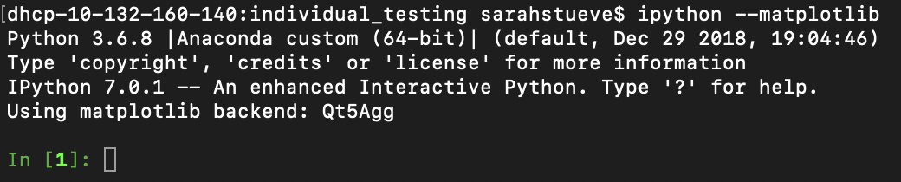
Using plot
Use the following command to use the plot method easily in your interpreter (if following along)

Slide 9
Using plot
Construct a DataFrame:
>>> index = [‘one’, ‘two’, ‘three’, ‘four’]
>>> columns = [‘A’, ‘B’, ‘C’, ‘D’]
>>> data = [[ 0, 1, 2, 3],
[ 4, 5, 6, 7],
[ 8, 9, 10, 11],
[12, 13, 14, 15]]
>>> frame = DataFrame(data, index, columns)
>>> frame
A B C D
one 0 1 2 3
two 4 5 6 7
three 8 9 10 11
four 12 13 14 15

Slide 10
Using plot
Transpose your Frame if necessary:
>>> frame = frame.T
>>> frame
one two three four
A 0 4 8 12
B 1 5 9 13
C 2 6 10 14
D 3 7 11 15

Slide 11
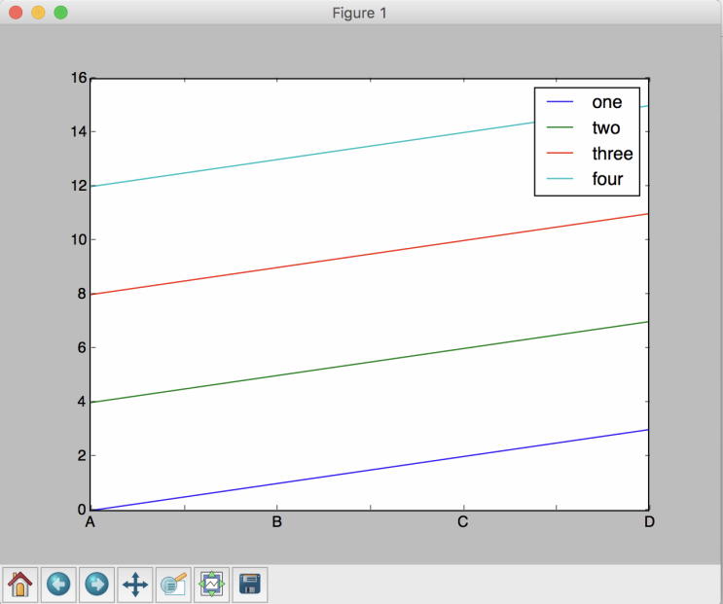
Using plot
Plot:
>>> frame.plot()
A plot window should pop up on your screen.

Slide 12
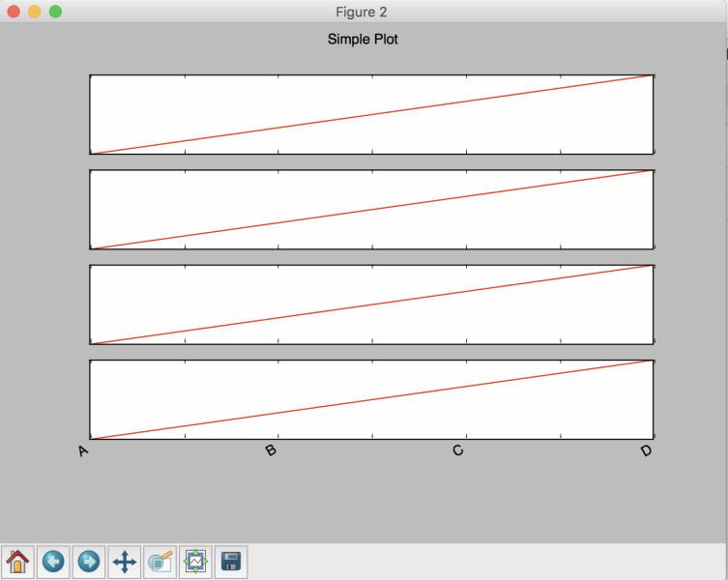
Using plot
Making subplots of your data:
>>> p = frame.plot(
subplots = True,
legend = None,
color = ‘r’,
yticks = []
title = ‘Simple Plot’)

Slide 13
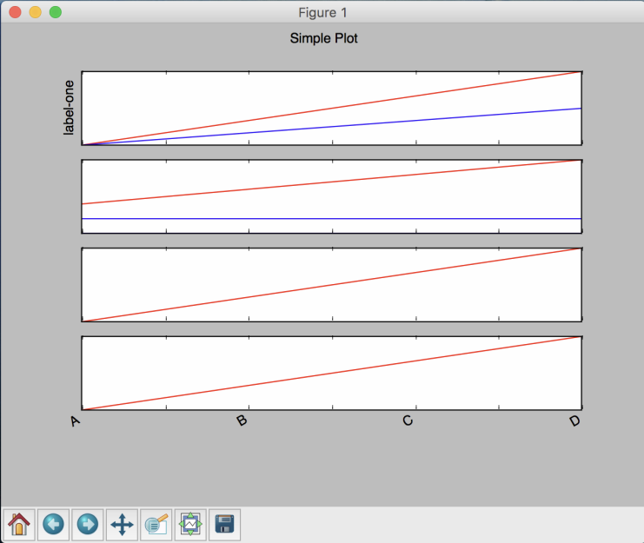
Using plot
Adding a curve to a line in a subplot:
>>> p = frame.plot(subplots=True, legend=None, color=‘r’,
yticks = [], title = ‘Simple Plot’)
>>> curve_like_line = Series([0, 0.5, 1, 1.5], [‘A’, ‘B’, ‘C’, ‘D’])
>>> curve_like_line.plot(ax = p[0])
>>> flatline = Series([2, 2, 2, 2],
[‘A’, ‘B’, ‘C’, ‘D’])
>>> flatline.plot(ax = p[1], color = ‘b’)
Setting a y-label to subplot:
>>> p[0].set_ylabel(‘label-one’)

Slide 14
Exercises
No exercises today.
Start or make some progress on your homework.

